Slide 1

SECURING DATA FROM ATTACKERS
TEAM NAME : INNOVATORS

Slide 2
PROBLEM STATEMENT
In our day to day life there may be risk of data secure and privacy and the solution for various ways in securing the data were also explained in the upcoming slides

Slide 3
OBJECTIVE
To secure our data from cyber attackers using various techniques
In day to day life our data’s and information were secured with the help of those techniques that were explained in the upcoming slides.
Generation of hash using MD5, SHA256,etc.. Were also explained in the upcoming slides

Slide 4
FLOW DIAGRAM
DATA INFORMATION
CONVERSION INTO HASH
ACCESS
KEY

Slide 5
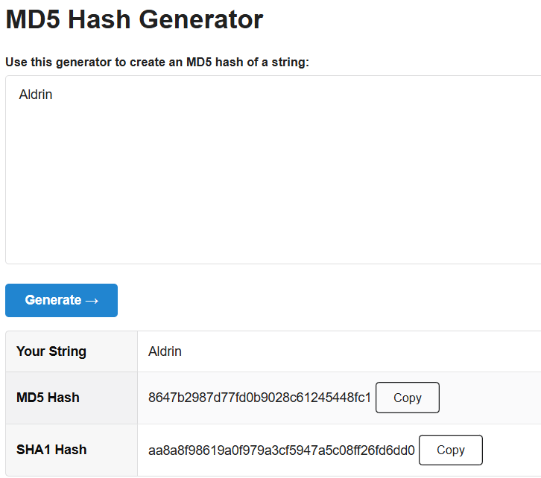
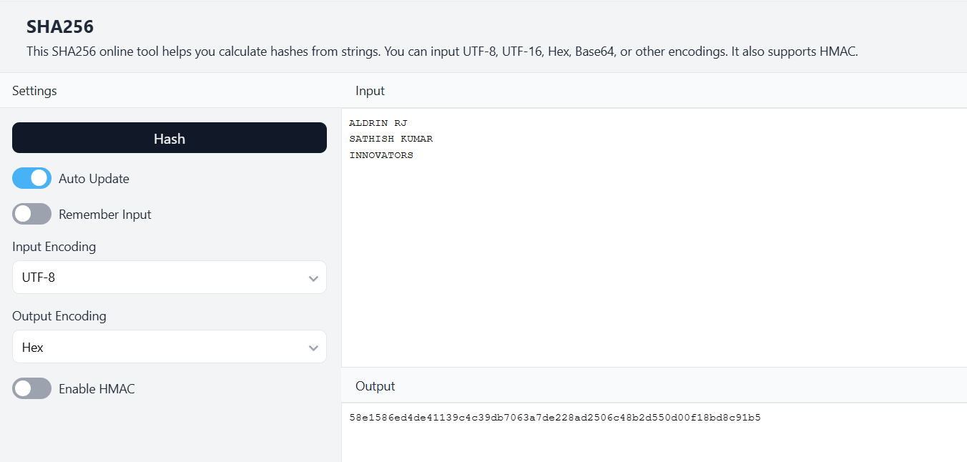
SCREENSHOTS OF GENERATED HASH

Slide 6
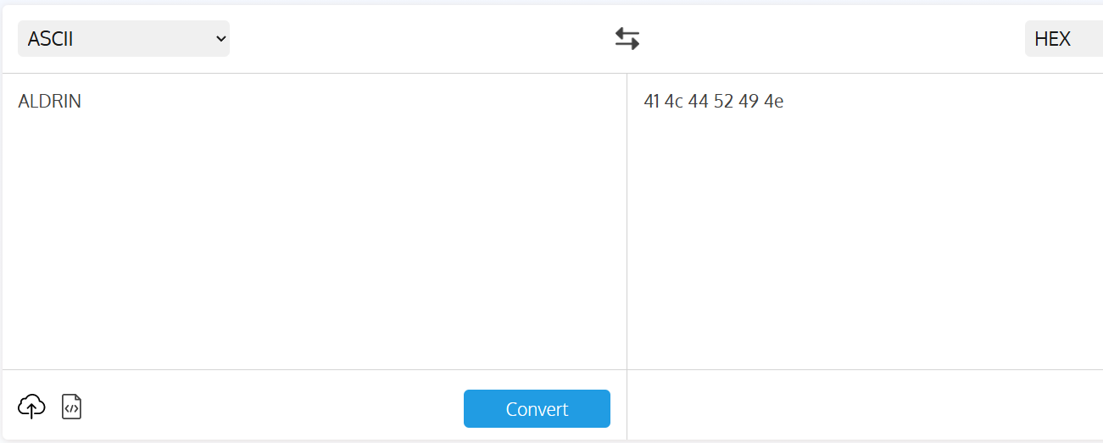
CONVERTING ASCII

Slide 7

THANK YOU

